Slide 1
Week 5 Lecture
Algorithms and Data Structures
      Dr Mehmet Bülent Özcan,
      (Module Leader/Lecturer/Tutor)
        Room: Cantor 9418
        Phone: extn 6900
        Email: m.b.ozcan@shu.ac.uk

Slide 2
Learning Objectives
To understand the queue data structure

Slide 3
Contents of the Lecture
Queues
Representation of Queue as an Abstract Data Type (Class)
States
Representation of Queues in Memory
Queue Representation
Singly Linked List Representation
Algorithms based on Array Representation

Slide 4
Queues
A queue is a linear list of elements in which deletions can take place only at one end, called the front, and insertions can take place only at the other end, called the rear. The terms “front” and “rear” are used in describing a linear list only when it is implemented as a queue.
Queues are also called first-in-first-out (FIFO) lists, since the first element in a queue will be the first element out of the queue. In other words, the order in which elements enter a queue is the order in which they leave. This contrasts with stacks, which are last-in-last-out (LIFO) lists.
An important example of a queue in computer science occurs in a timesharing system, in which programs with the same priority form a queue while waiting to be executed. This ignores the possible existence of priorities, in which case there will be one queue for each priority.

Slide 5
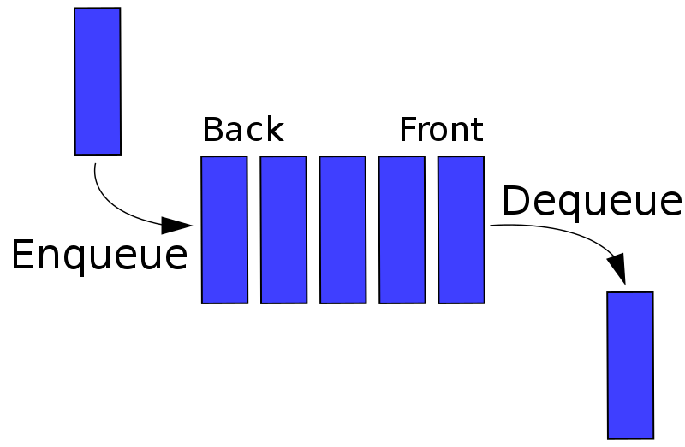
Queues (2)

Slide 6
Representation of Queue as an Abstract Data Type (Class)
If we regard a queue as an object, we can represent it using the UML (Unified Modelling Language) notation as shown below:

Slide 7
Representation of Stack as an Abstract Data Type (Class) (2)
Attributes represent data, which queues are associated with or handle.
Operations represent functions that are applicable to queues to handle data. They collectively represent a queue’s behaviour.
States, which are not included in the UML notation, constrain the operations applicable to a queue.

Slide 8
States
Empty: A queue can be empty under two circumstances:
  when it is created
  when all items stored in it are deleted
Empty constrains two operations. Thus, this state must be checked before applying them. They are:
  getFront(): it is not possible to retrieve an item when a queue is empty.
  deleteQ: it is not possible to remove an item from an empty queue.
Full: A queue can be full under the following circumstance.
  When its capacity is exhausted.
Full constrains one operation. Thus, this state must be checked before applying it. It is:
  addQ(): it is not possible to insert an item when a queue is full.

Slide 9
Representation of Queues in Memory
Queues may be represented in the computer various ways, usually by means of a singly linked list or a linear array.
We will outline both representations but focus only on the array representation in this lecture.
declare Queue[0..max-1], front, rear, item

Slide 10
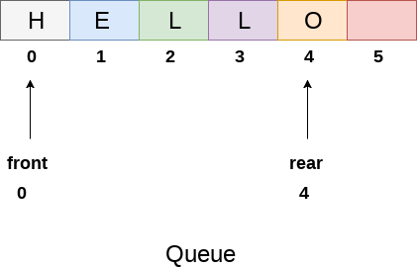
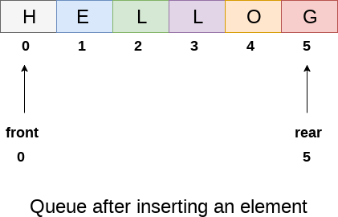
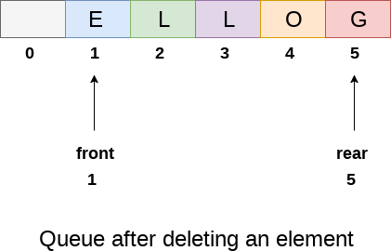
Array Representation and possible implementation

Slide 11
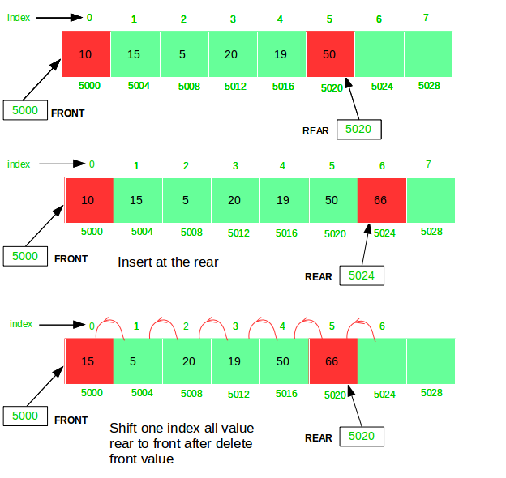
Array Representation and possible implementation (2)

Slide 12
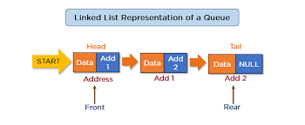
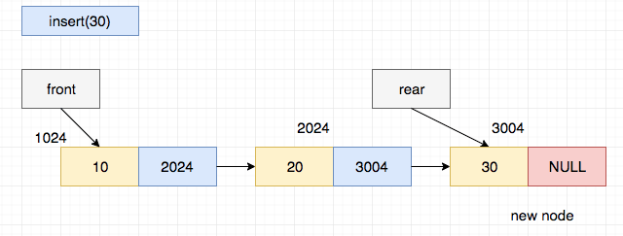
Singly Linked List Representation

Slide 13
ADL Syntax for Abstract Data Types (Class)
CLASS <name>
STATES
{state} // a set of states
REPRESENTATION
// Memory representation, e.g., array
OPERATIONS
{operation} // a set of operations
ALGORITHMS
// a set of precondition and algorithm for each operation
{<precondition> <algorithm>}
END

Slide 14
Array Representation- Algorithms
CLASS Queue
STATES
full, empty /* full means a full stack, etc. */
REPRESENTATION
declare QUEUE[0..max-1], front, rear, item
OPERATIONS
procedure create()
procedure addQ(IN item)
procedure deleteQ(OUT item)
function getFront()
function getRear()
function isEmpty()
function isFull()

Slide 15
Array Representation- Algorithms (2)
AlGORITHMS
Precondition: true (i.e., there is no precondition).
procedure create()
front ← -1
rear ← -1
end

Slide 16
Array Representation- Algorithms (3)
Precondition:
if isFull(IN rear, IN max) = true then CALL queueFULL()
endif
procedure addQ(IN item)
rear ← rear + 1
Queue(rear) ← item
end

Slide 17
Array Representation- Algorithms (4)
Precondition:
if isEmpty(front, rear) = true then CALL queueEMPTY()
endif
procedure deleteQ(OUT item)
front ← front + 1
item ← QUEUE(front)
end

Slide 18
Array Representation- Algorithms (5)
Precondition:
if isEmpty(front, rear) = true then CALL stackEMPTY()
endif
function getFront()
return QUEUE(front+1)
end

Slide 19
Array Representation- Algorithms (6)
Precondition:
if isEmpty(front, rear) = true then CALL stackEMPTY()
endif
function getRear()
return QUEUE(rear)
end

Slide 20
Array Representation- Algorithms (7)
Precondition: true Precondition: true
function isEmpty(IN front, IN rear) function isFull(IN rear, IN max)
if front = rear then return true if (rear = max) then
else return false return true
endif else return false
end endif
end
END

Slide 21
Array Representation- Algorithms (8)
Notice that there is a problem with these algorithms.
To quote Horowitz and Sahni, “That is, the queue will gradually move to the right. One obvious thing to do
either
  when queueFull() is signalled is to move the entire queue to the left so that the first element id again QUEUE(1) and front = 0. This is time consuming, especially when there are many elements in the queue at the time of the queueFull() signal.”
or
  Move the entire queue to the left every time an item is removed from the queue a shown in Slide 11.
Question: which alternative is more time efficient?

